Slide 1
Database Design Strategies
Database Systems Presentation

Slide 2
Group Members Info
Taimoor Ul Islam (14031)
Sayeed Tauheed Shah (14143)

Slide 3
Content
Introduction
Database Design Principles
Database Design Strategies
Database Tools and Technologies
Cases Studies
Q&A Session

Slide 4
Introduction
What is database design
and why it is important ?
Database design encompasses the process of structuring and organizing data within a database system to meet specific requirements and objectives. It involves defining the database schema, tables, relationships, constraints, and other elements necessary for efficient data storage, retrieval, and manipulation.
Impact on Performance
Scalability and Adaptability
Foundation for Decision Making

Slide 5
Design Principles
Normalization
1st , 2^{nd, 3rd} Normal Form
Denormalization
Improving Querying
Data Integrity
Constraints
BCNF Normal Form
Reducing joints
Triggers
Reference

Slide 6
Continue…
Scalability
Horizontal Vs Vertical Scalability
Sharding
Performance Optimization
Indexing
Replication
Query Optimization
Partitioning
Caching
Compression
Benchmarking and Profiling Techniques

Slide 7
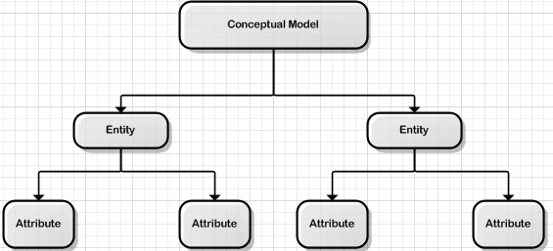
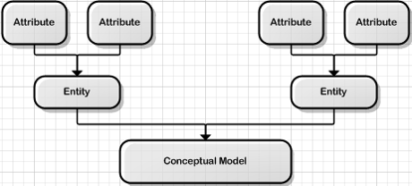
Design Strategies
Top Down Approach
Top Down Approach
The top-down design method starts from the general and moves to the specific. This process involves the identification of different entity types and the definition of each entity’s attributes.
Bottom Up Approach
The bottom-up approach begins with the specific details and moves up to the general. In other words, this method first identifies the attributes, and then groups them to form entities.
Bottom Up Approach

Slide 8
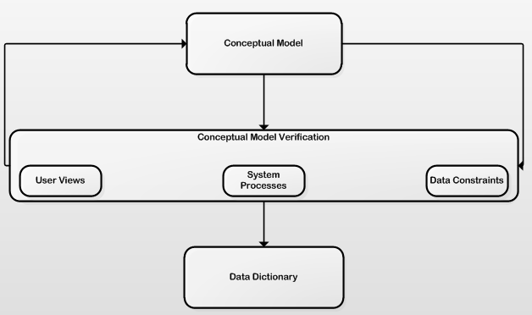
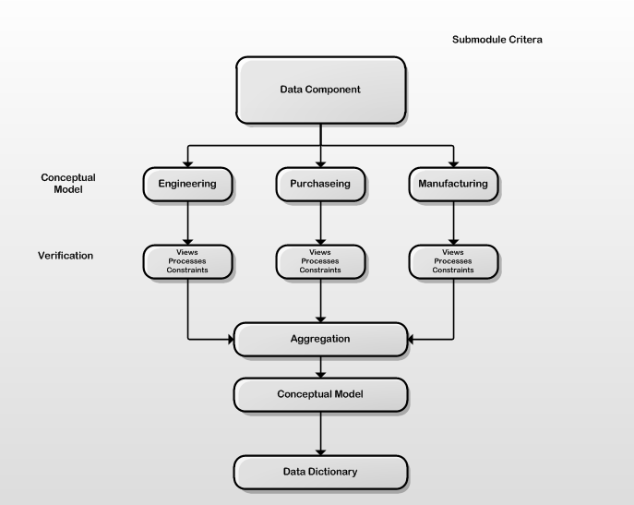
Continue…
Centralized design
Centralized design
Centralized design is typical of a simple or small database and can be successfully done by a single database administrator or by a small design team.
Decentralized design
This is commonly accomplished by several teams that work on different subsets or modules of the system.
Decentralized design

Slide 9
Design Tools and Technologies
Tools
Technologies
ER-Modeling
Lucidchart
ER/Studio
DBMS
MySQL
PostgreSQL
Microsoft Visio
Oracle Database
Microsoft SQL Server
MongoDB
NewSQL databases are a class of relational databases that aim to combine the scalability of NoSQL databases with the ACID (Atomicity, Consistency, Isolation, Durability) guarantees of traditional SQL databases.
Newsql Databases
NoSQL (Not Only SQL) databases are non-relational database management systems designed to handle large volumes of unstructured or semi-structured data.
Nosql Databases

Slide 10
Case Studies
Successful Databases
Database Failures
Facebook's Social Graph Database
Amazon's Dynamodb
MySpace Data Loss Incident
LinkedIn's Database Outage

Slide 11
Q&A Session
Please feel free to ask any question.

Slide 12
Thank You

